Slide 1

2022 Divvy bicycle usage data analysis

Slide 2



Questions
findings
answers

Slide 3
Business related Questions
How do annual members and casual riders use Cyclistic bikes differently?
Why would casual riders buy Cyclistic annual memberships?
How can Cyclistic use digital media to influence casual riders to become members?

Slide 4
Information regarding the data
Data is from official trip data of Divvy bike in 2022
Calculated ride length for each ride by subtracting start time from the end time
Information about member status for each ride was also available
Assigned the date of the week to each ride where Sunday = 1 to Saturday = 7.

Slide 5
Findings

Slide 8
Average ride length for the day of the week

Slide 9
Average ride length for the day of the week(cont.)

Slide 10
Answers

Slide 11
How do annual members and casual riders use Cyclistic bikes differently?
Notes:
Annual members generally had shorter hours of cycle usages than the casuals. Also, their fluctuation based on the day of the week and for each month was considerably smaller than casuals. Casuals tend to ride way more during the summer and weekends.

Slide 12
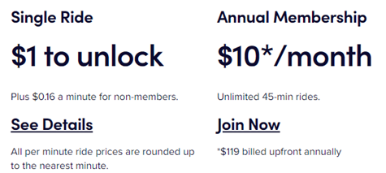
Why would casual riders buy Cyclistic annual memberships?
Notes:
The annual membership costs $10 monthly, which is $120 annually. However, a single ride costs $1 to begin and $0.16 additional cost for every minute. Casual riders ride bikes longer than 20 minutes on average for every ride. It is a bit shorter for winter and longer for summer but on average it is longer than 20 minutes. This way it is worthy buying an annual membership if they ride it more than two times each month, since it will cost them $12.6 without the membership where it is $10 with a membership.

Slide 13
How can Cyclistic use digital media to influence casual riders to become members?
Notes:
Divvy must advertise the fact that many casual riders can save their money through annual membership. The data says that many casuals can save their money through membership if they ride longer than 15 minutes, and more than two times every month, or longer than 25 minutes and ride more than once. Many casuals fit into this categories and not know that they can save money through membership so the company must be advertising through digital medias.

Slide 14
Thank you for your time

